Slide 1

Speed Optimisation of Superconducting Magnetic Bearings
By Timothy Allen
Acknowledgements – Dr. Mohammad Siamaki, Dr. James Storey
2024

Slide 2
Introduction
What are the problems with mechanical and magnetic bearings?
What are superconducting magnetic bearings?
What are the challenges in using superconducting magnetic bearings?
Notes:
Friction(damage, heating, losses). Instability, use of energy and strength.
Type-2 Superconductors and flux pinning.
AC losses, cooling
Explicit…

Slide 3
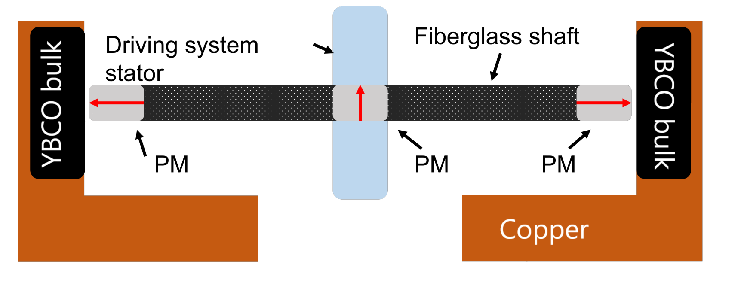
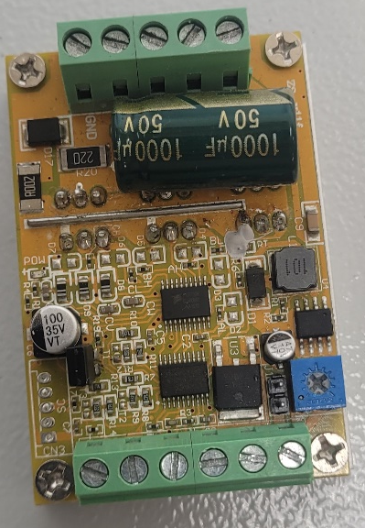
Project premise
Increase the speed of the horizontal shaft
Notes:
Already set up shaft works like so.
Spun up to 120,000 rpm before instability.

Slide 4
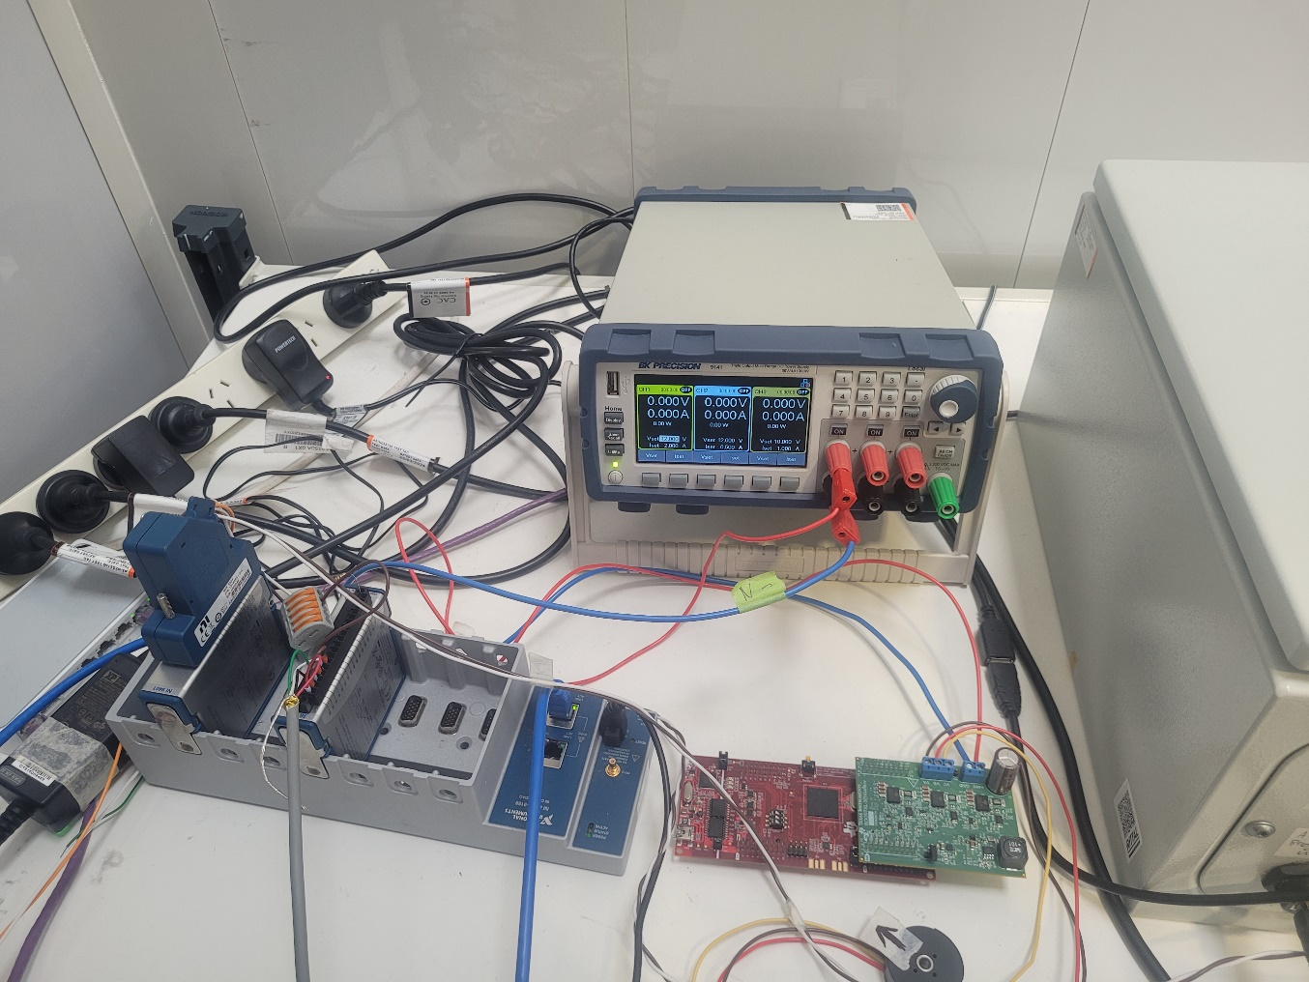
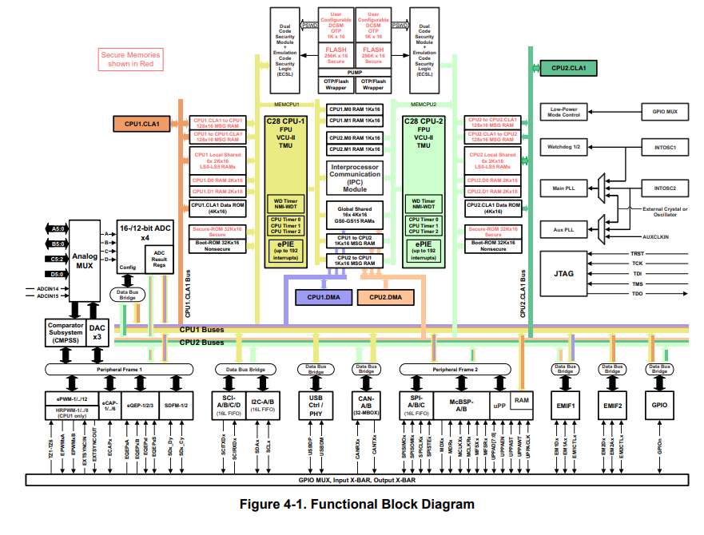
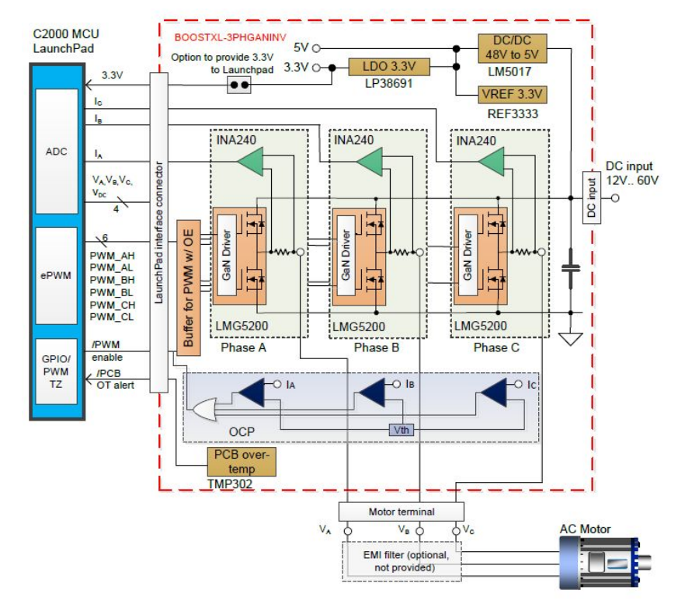
Set-up
Notes:
LabVIEW, DAQ, control box, Booster and Launchpad

Slide 5
Solutions
Magnetic field mapping
Magnets for shaft have reduced inhomogeneity
Improved motor driver
Less noise
More customisable

Slide 6
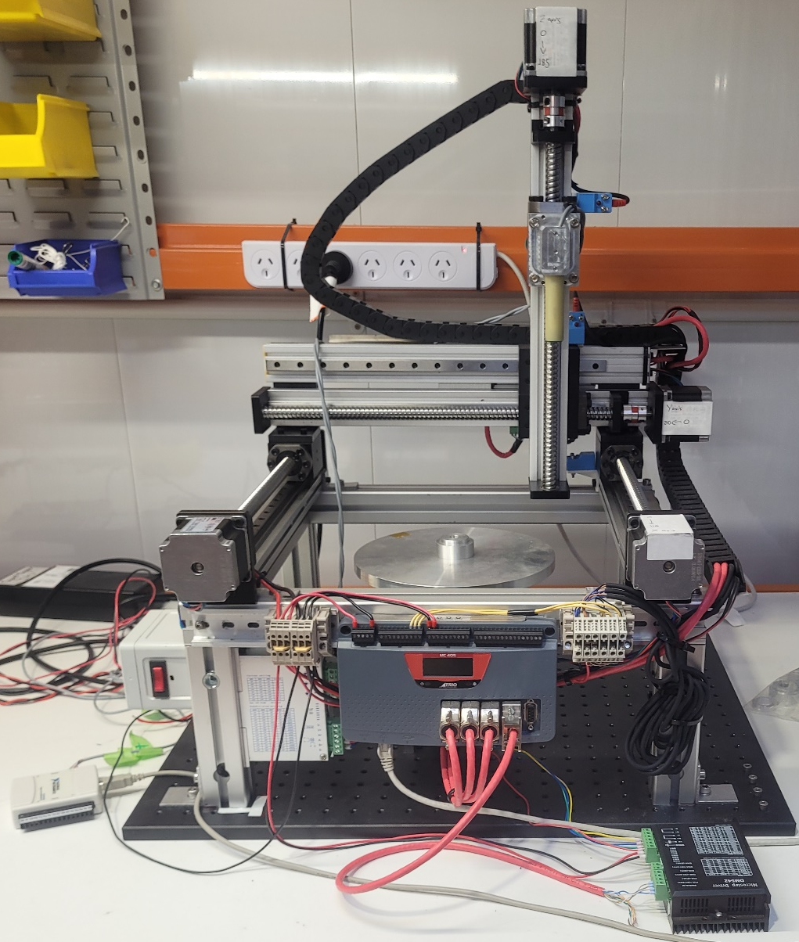
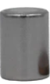
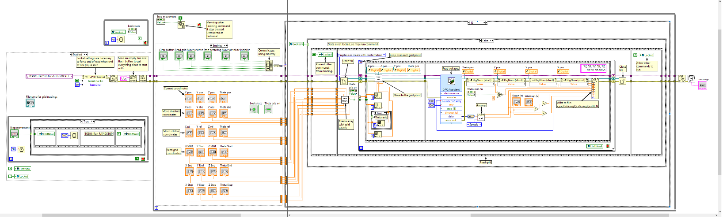
Magnetic field mapping
Overview
Rig
LabVIEW
Magnets
9.53mm dia x 12.70mm long
Notes:
3D printer-like rig to position the hall sensor
Should mention LabVIEW
Set of 12 magnets (dimensions)

Slide 7
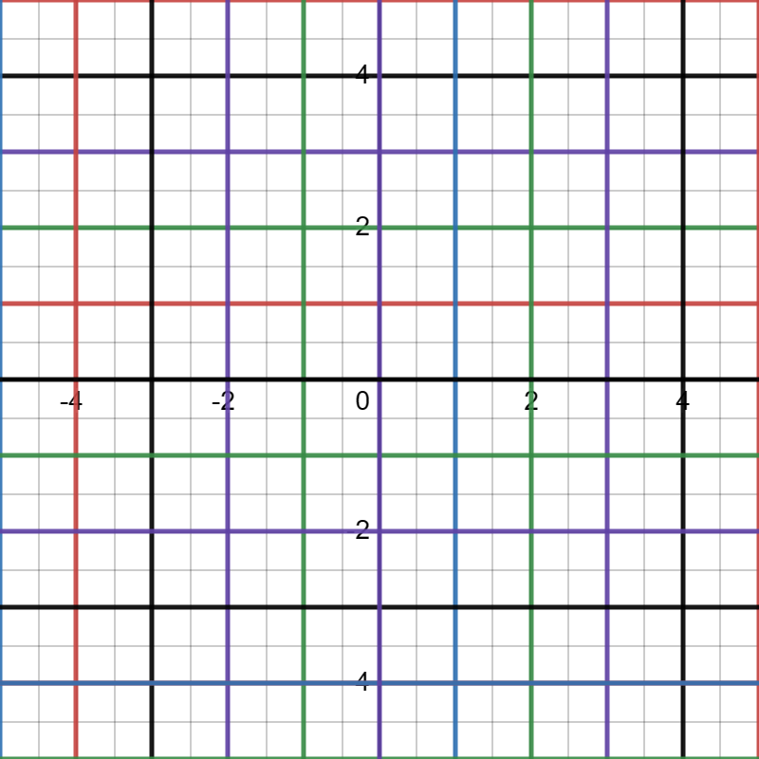
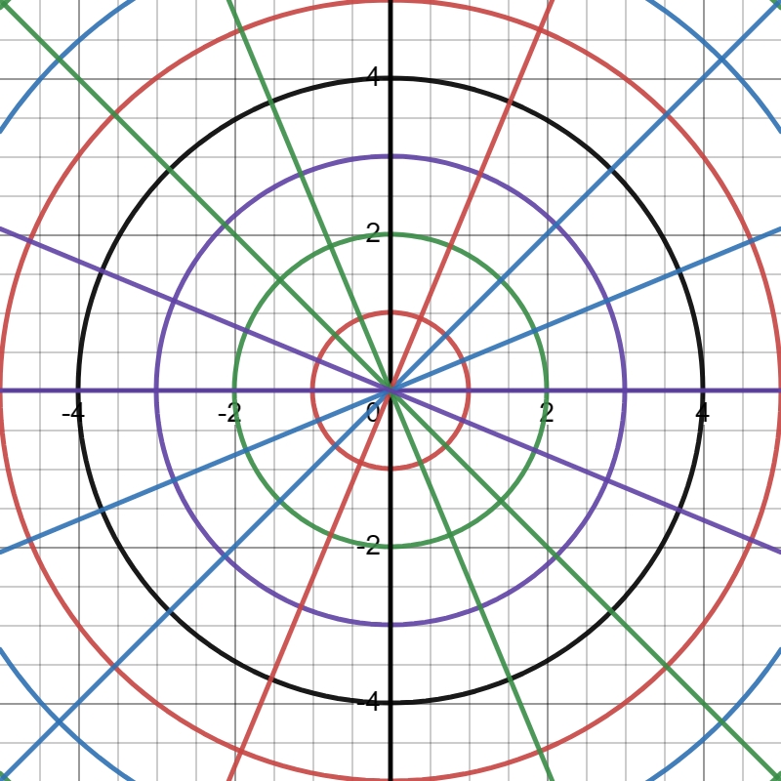
Rectangular and rotational measurements

Slide 8
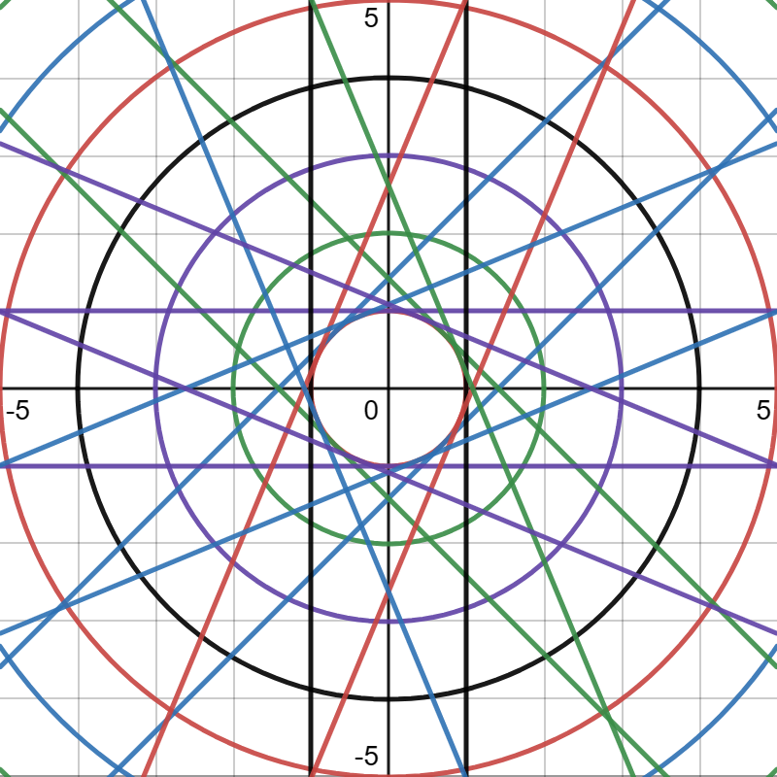
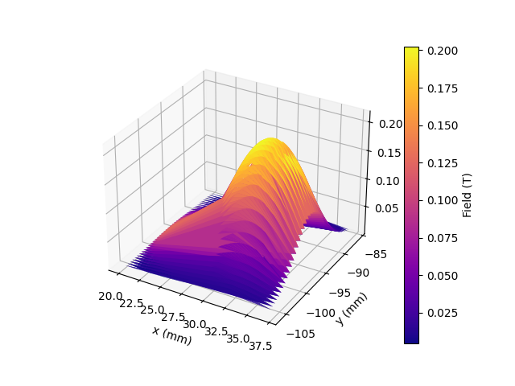
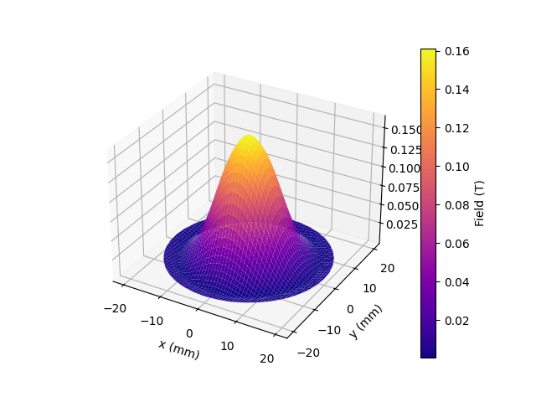
Difficulties in mapping the magnetic fields
Misalignment
Centering
Time
Accuracy determination
Notes:
Point out edges not aligned
(~7 hrs)
Missing data, my changes

Slide 9
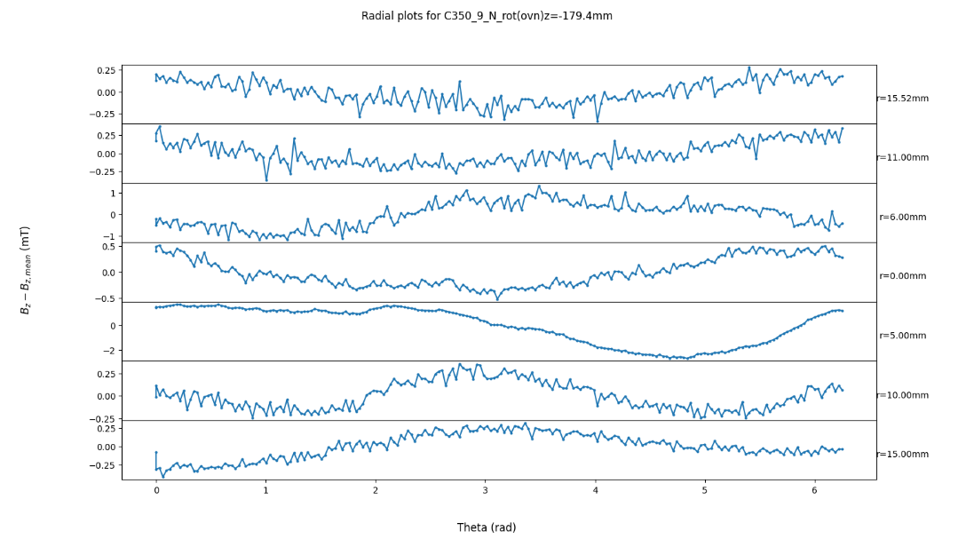
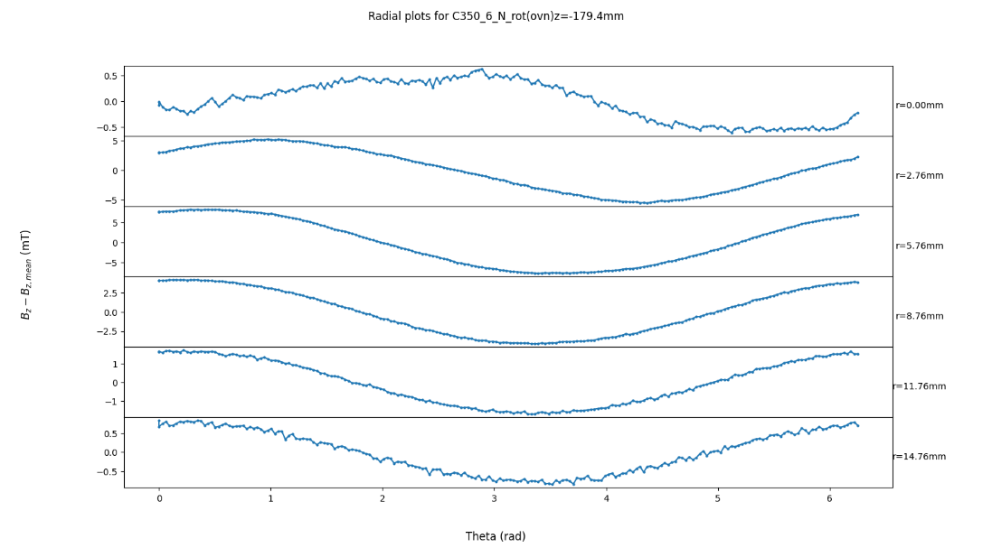
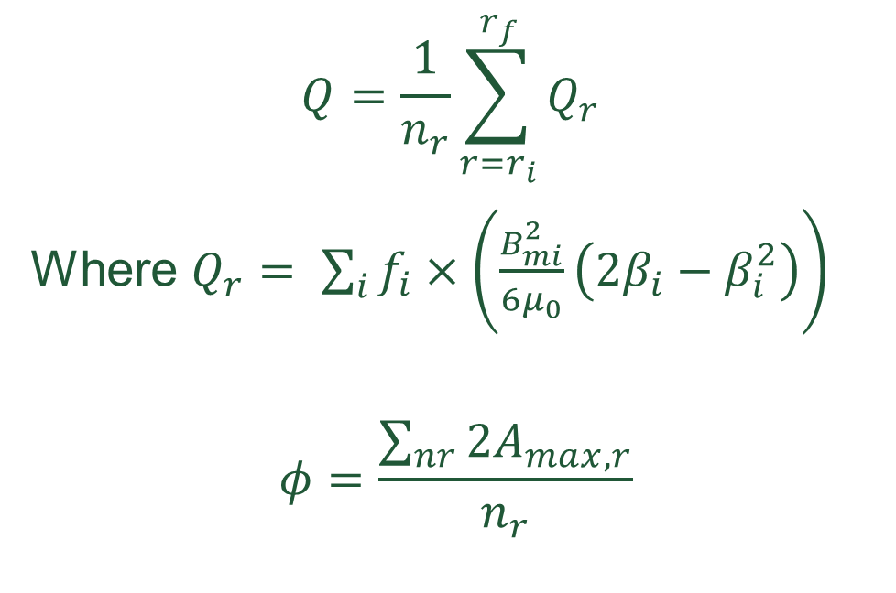
Calculations
$$Q=\frac{1}{n_{r}}\sum_{r=r_{i}}^{r_{f}}{Q_{r}}$$
Where $Q_{r}= \sum_{i}{f_{i}}×\left(\frac{B_{mi}^{2}}{6μ_{0}}\left(2β_{i}−β_{i}^{2}\right)\right)$
$$φ=\frac{\sum_{nr}{2A_{max, r}}}{n_{r}}$$

Slide 10
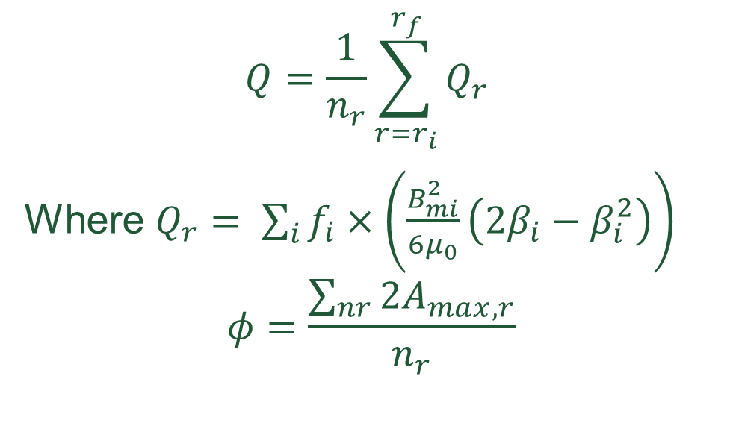
The best magnets
$$Q=\frac{1}{n_{r}}\sum_{r=r_{i}}^{r_{f}}{Q_{r}}$$
Where $Q_{r}= \sum_{i}{f_{i}}×\left(\frac{B_{mi}^{2}}{6μ_{0}}\left(2β_{i}−β_{i}^{2}\right)\right)$
$$φ=\frac{\sum_{nr}{2A_{max, r}}}{n_{r}}$$
Magnet 10 is the best, then 9, with 2 close behind.
Notes:
Characterised with change in amp

Slide 11
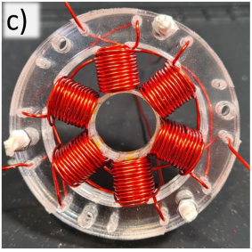
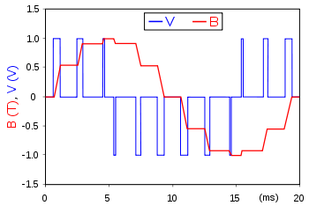
Motor control
AC motor
PWM motor control
Location for rotor
Windings
Stator
Notes:
Phase moves around pulling the magnet towards it
PWM for accurate control

Slide 12
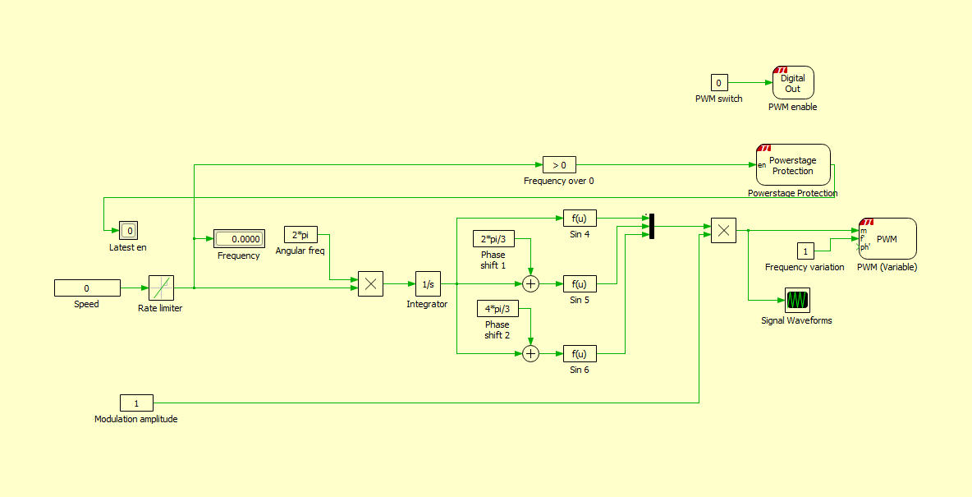
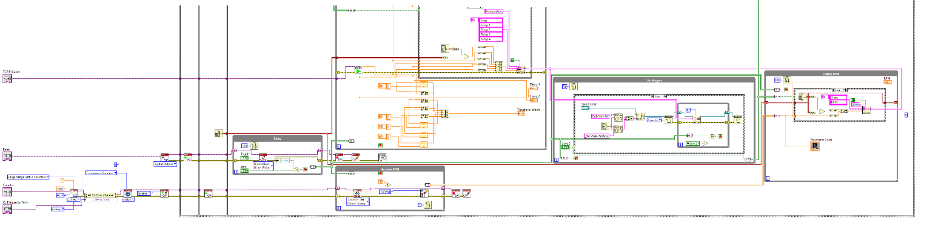
Difficulties in making a motor driver
The boring stuff
Analog pins inaccuracy
Averaging
Offsets
Variable frequency sine waves

Slide 13
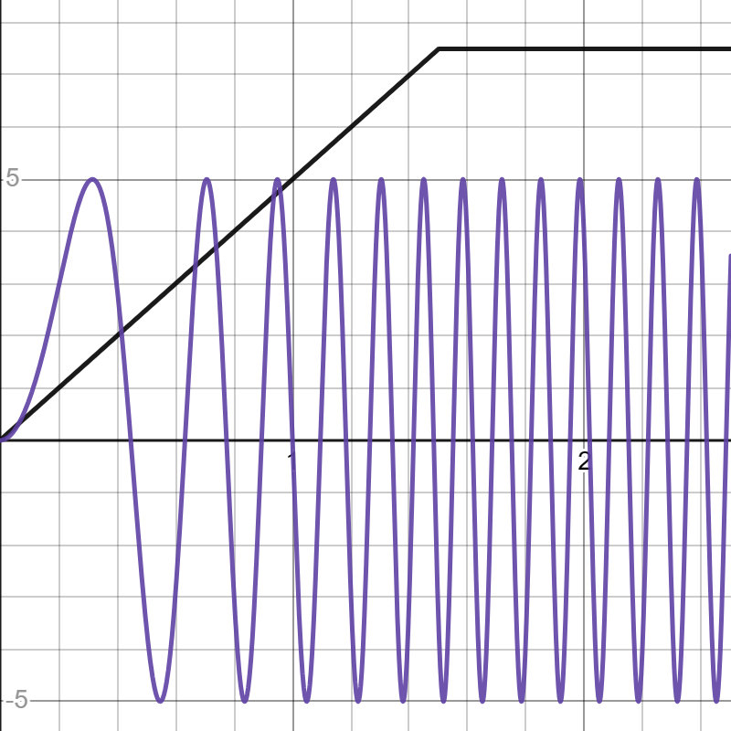
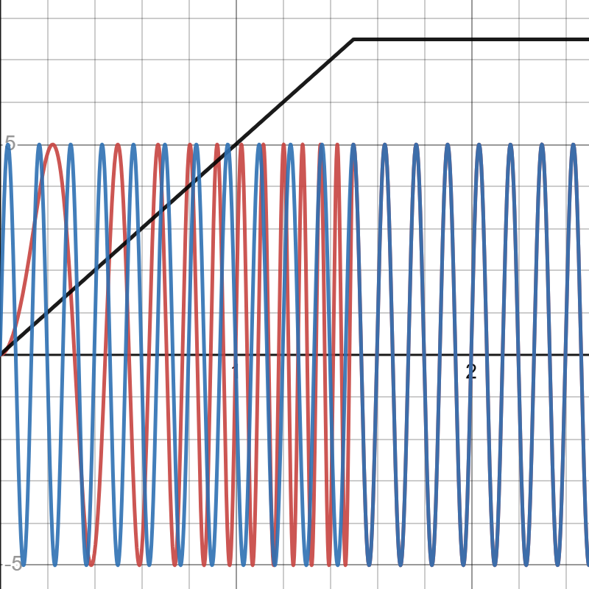
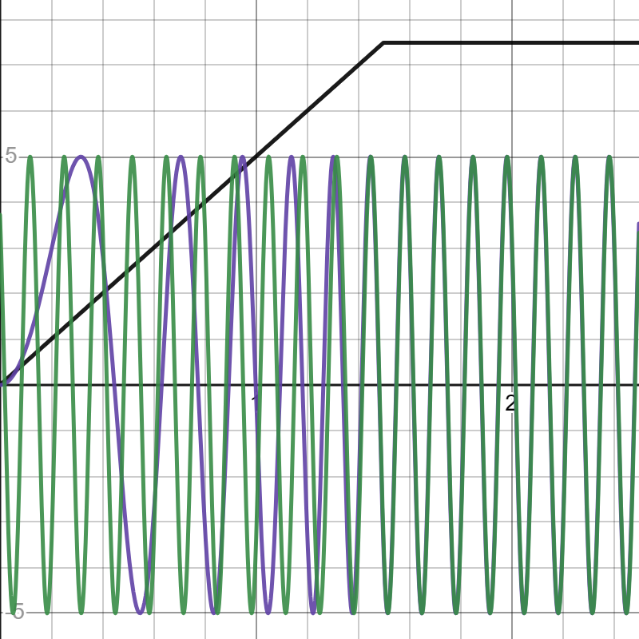
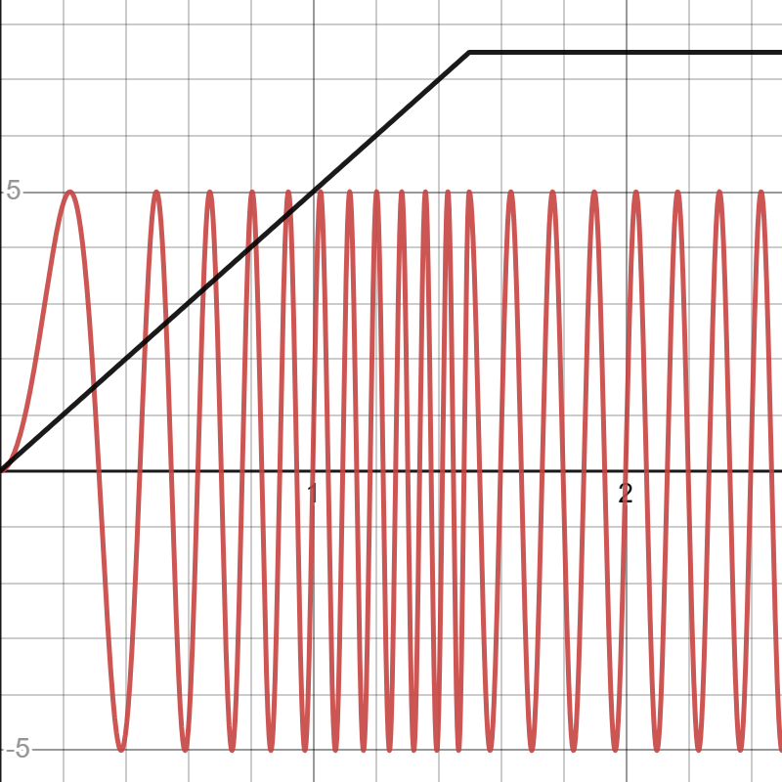
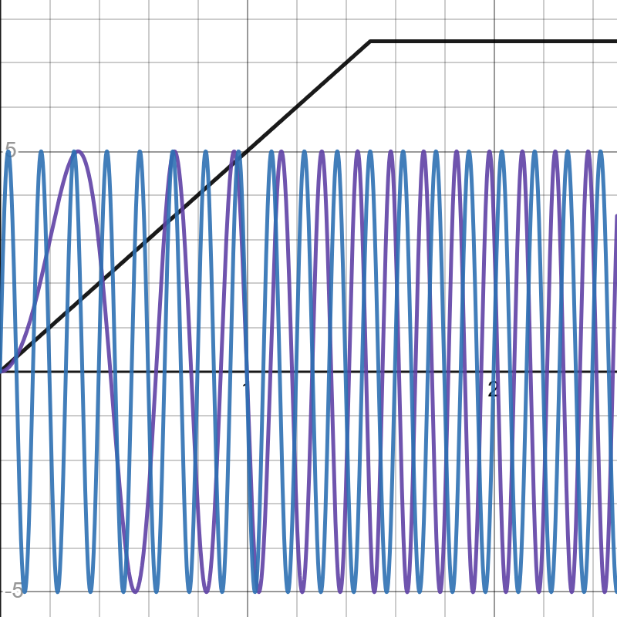
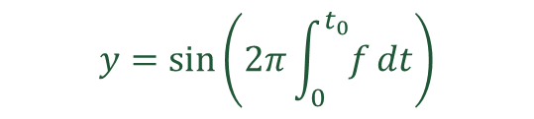
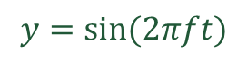
Ramping sine waves
$$y=sin⁡(2πft)$$
$$y=\sin\left(2π\int_{0}^{t_{0}}{f}dt\right)$$

Slide 14
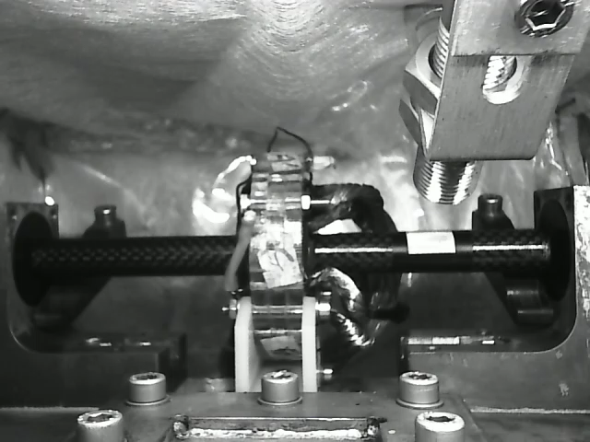
Driving at 96,000 rpm

Slide 15
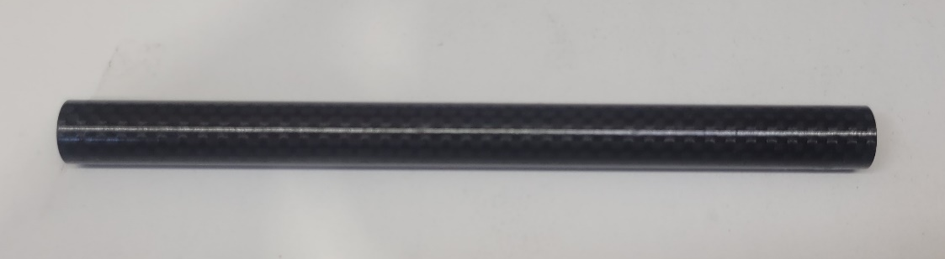
Where are we now?
VVVF
Motor constant
Sensorless driving
Back emf
New shaft
Sensor
The new shaft that is being manufactured with better magnets.

Slide 16
Thank you
Questions?

Slide 17


Slide 18
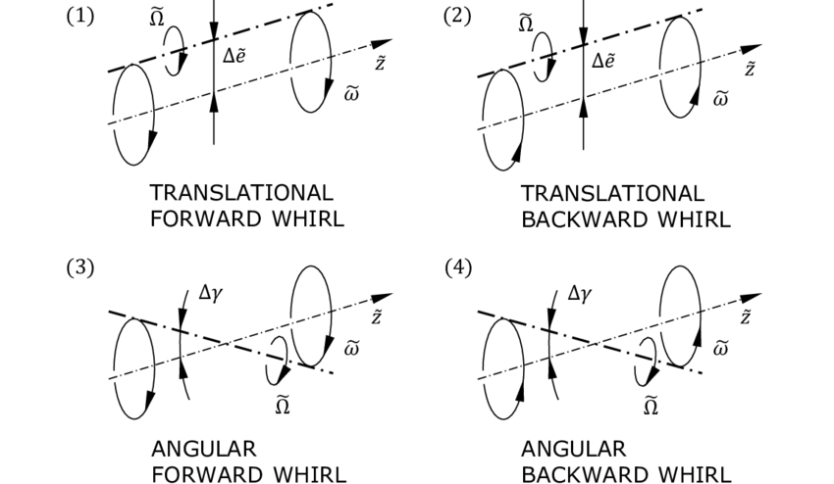
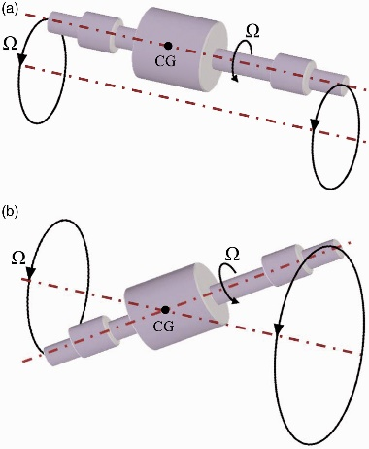
Rotor dynamics -a short aside
Centres of magnetism
Cylindrical and conical modes
Notes:
Alignment of centres changes the form of drag forces
FEM to determine true best magnets for stability

Slide 19
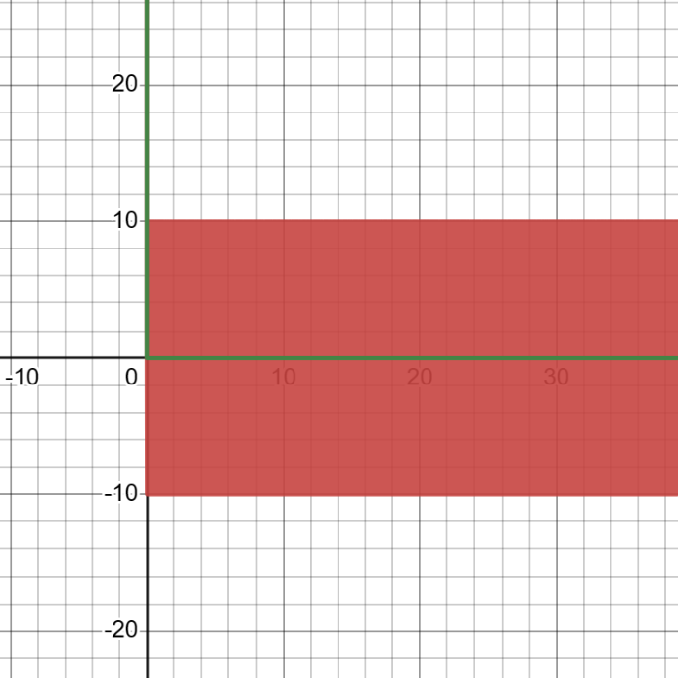
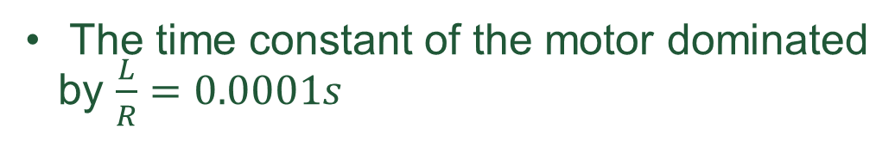
Inrush Current
The time constant of the motor dominated by $\frac{L}{R}=0.0001s$
$I\left(t\right)=\frac{V_{0}}{ \sqrt{R^{2}+{\left(ωL\right)}^{2}}}\left(\cos\left(ωt−δ−\arctan\left(\frac{ωL}{R}\right)\right) −\cos\left(δ+\arctan\left(\frac{ωL}{R}\right)\right)e^{−t\left(\frac{R}{L}\right)}\right)$

Slide 20
Abstract
Superconducting magnetic bearings (SMBs) utilize type-2 superconductors and permanent magnets to achieve frictionless levitation. Despite losses from magnetic field inhomogeneities, optimising SMBs remains limited. I have enhanced the speed of a levitating horizontal shaft to 96,000 rpm by adjusting motor control and characterising magnet inhomogeneity. Reducing rotational inhomogeneity is crucial for SMB stability and loss reduction. SMBs offer frictionless operation, minimal wear, and higher speeds, potentially replacing mechanical bearings and improving standard magnetic bearings, especially in large-scale applications with cooling capabilities. Further research aims to enhance SMB stability and reduce energy expenditure.
Notes:
Abstract

